Slide 1
INTEGRATING THIRD PARTY LIBRARIES
S.KOUSHIK KUMAR
ROLL NO : 22H51A0554
SECTION : CSE-D

Slide 2
THIRD PARTY LIBRARIES
Third-party libraries are external packages that provide pre-built components, utilities, or functionalities which can be integrated into your React applications.

Slide 3

POPULAR LIBRARIES
React Router: Enables routing in single-page applications.
Axios: A library for making HTTP requests.
Material UI: Provides pre-designed UI components for React.
Redux: A state management library for large-scale React applications.
Formik: For managing forms and form validation.

Slide 4
INTEGRATION
PROCESS
1.Install the Library : The first step is to install the third-party library using npm (Node Package Manager).
2.Import the Library into Your React Component :
This imports the library so that you can use it in the component.

Slide 5
INTEGRATION
PROCESS FOR AXIOS
1.Install the Library :
npm install axios
2.Import the Library into Your React Component :
import axios from 'axios';

Slide 6
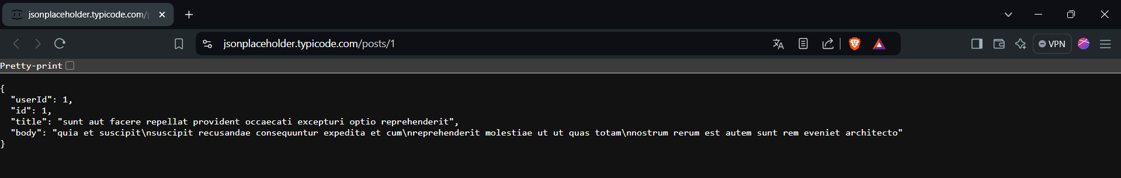
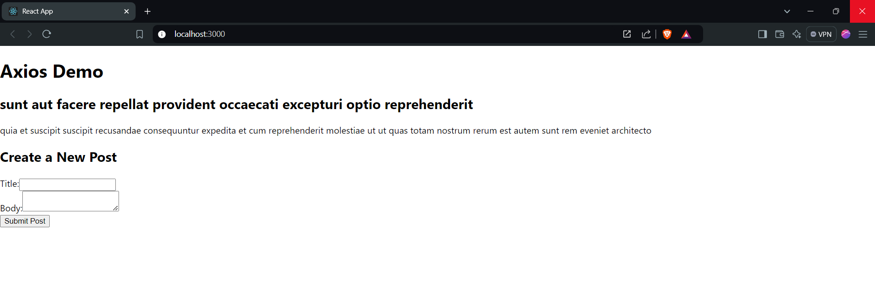
This is an API where some info is present
This is the output where we can fetch the info from the api and also post the data.

Slide 7
CONCLUSION
Integrating third-party libraries into a React project is a powerful strategy for enhancing your application's capabilities and efficiency. Careful selection and integration of these libraries, while ensuring they are compatible and well-maintained, can lead to a more robust and feature-rich application.

Slide 8
THANK YOU

